Slide 1


Slide 2
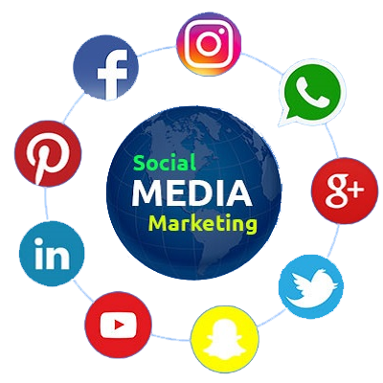
Intro to Social Media Marketing

Slide 3
What is Social Media Marketing?
Definition
The use of social media platforms to promote products, services, and brands
Importance
Connects businesses with a broader audience
Drives website traffic, increases sales, and builds brand loyalty

Slide 4
Key Social Media Platforms
Overview of Major Platforms
Facebook
Broad user base, versatile content types
Instagram
Visual storytelling, effective for brands targeting younger demographics
Twitter
Real-time updates and customer engagement
LinkedIn
Professional networking, B2B marketing
TikTok
Short-form videos, rapidly growing platform for creative engagement
Choosing the Right Platform
Consider your target audience and business goal

Slide 5
Developing a Social Media Strategy
Key Components
Goals
Define clear, measurable objectives (e.g., brand awareness, lead generation)
Target Audience
Identify demographics, interests, and behaviors
Content Plan
Types of content to share (images, videos, blogs) and posting frequency
Examples of Goals
Increase followers by 20% in 3 months
Drive 500 website visits per month from social media

Slide 6
Content Types for Social Media
Types of Content
Promotional Posts
Define clear, measurable objectives (e.g., brand awareness, lead generation)
Educational Content
Identify demographics, interests, and behaviors
User-Generated Content
Showcase customer photos and reviews
User-Generated Content
Showcase customer photos and reviews
Visuals
Use high-quality images and videos to capture attention

Slide 7
Organic vs. Paid Social Media
Organic Social Media
Building an audience through regular posts, engagement, and content sharing
Focus on relationship-building and community engagement
Paid Social Media Advertising
Creating targeted ads to reach specific demographics
Benefits
Instant visibility, measurable results, and retargeting capabilities

Slide 8
Creating Engaging Social Media Content
Best Practices
Know Your Audience
Tailor content to their interests and preferences
Consistency
Maintain a consistent brand voice and posting schedule
Engagement
Respond to comments and messages promptly
Analytics
Monitor performance and adjust strategies based on insights

Slide 9
Tools for Social Media Management
Popular Tools
Hootsuite
Scheduling and analytics across multiple platforms
Buffer
Easy post scheduling and performance tracking
Canva
Graphic design tool for creating social media visuals
Choosing the Right Tool
Consider budget, features, and ease of use

Slide 10
Measuring Success in Social Media Marketing
Key Metrics
Engagement Rate
Likes, comments, shares, and interactions
Reach and Impressions
How many people see your content
Conversion Rate
Percentage of users taking desired actions (e.g., clicks to website)
Tools for Analytics
Use built-in analytics on social platforms and tools like Google Analytics

Slide 11
Discussion Questions
What social media platforms do you find most effective for marketing, and why?
(Encourage participants to share their opinions)
Have you seen any successful social media campaigns that inspired you?
Facilitate discussion about successful campaigns and strategies

Slide 12
Next Steps and Final Project
Final Project Overview
Create and optimize a Facebook or Instagram business page for a local business or personal brand

Slide 13


Slide 14


